Slide 1

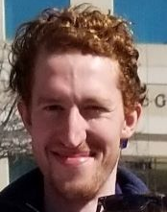
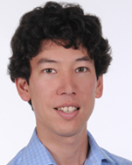
PMP meet-and-greet
Leadership team:
Notes:
This is a test

Slide 2
Outline
What is mentoring?
PMP rights and responsibilities

Slide 3
What is mentoring?
Insert Phong’s analogy here

Slide 4
PMP details
The mentor and the mentee must meet ≥ once a quarter
Starbuck cards will be distributed to the mentors every quarter
No homework!
Pre- and post- surveys
Very important point about assigned mentor

Slide 5
Questions?? Great, wait until I’m drinking

